Slide 1

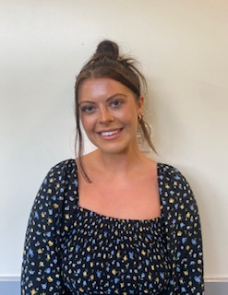
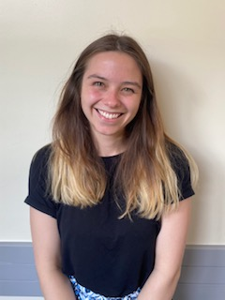


NEWSLETTER
7th July 2023
Sports Day
A reminder to parents about our upcoming Sports Days. If you would like attend please arrive at school 15 minutes before the start time. Cold drinks and lollies will be available to purchase on the day. We advise parents to also wear sun cream and hats due to the likelihood of hot weather. Please send extra sun cream with your child.
Year Group: | Date and Time:
Year 3 & 4 | Tuesday 11th July - 10:00am
Year 1 & 2 | Tuesday 11th July – 1:30pm
EYFS | Wednesday 12th July - 9:15am
Year 5 & 6 | Thursday 13th July - 1:45pm
Meet the Teacher
Miss Morley (Year 4) and Miss Vernon (Year 3), who will be joining us next year, will be on the playground on Monday morning to meet parents and children ahead of transition.
Miss Morley
Miss Vernon
RE opportunity
Year 4 are really looking forward to welcoming a visitor on Monday who will speak to the year group about why pilgrimages are an important part of faith to follow up their RE work around special journeys that people make.
Learners Codes
We've been delighted to see so many bronze and silver leaners, recognised for showing our school values this year. The children will be able to bring home their learners' codes for you to see at the end of term as they will have brand new ones when they come back in September. We're looking forward to seeing even more bronze, silver and even gold learners next year!
House Name: | Total House Points:
Diamond | 9717
Emerald | 9528
Ruby | 9681
Sapphire | 9987
House Points
The race is on - each House has been set the challenge to achieve 10,000 house points by the end of the year. Our Sports Day events will give them the very best opportunity as each house currently has over 9,000...

Slide 2

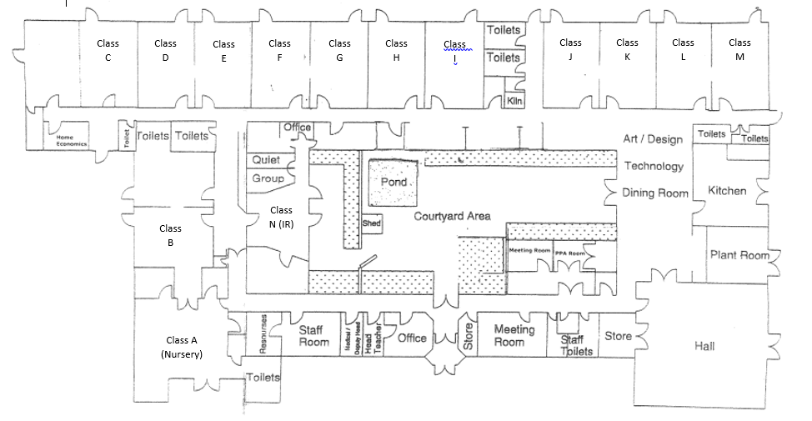
Transition
On Monday afternoon, the children will spend time in their new classes looking at the exciting plans for September and getting to bond as a team. They will return to class just before home time so will be collected from their current classrooms at the end of the day.
On Wednesday afternoon, the children will go to their new classes again, but this time they will go home from their new classrooms from September(shown below) so that you can pop in and meet your child's new teacher.
We know that the staff and children are really excited for September so we're looking forward to seeing a preview of the new classes next week.
Please see below a Class/School map starting from September. (The children will be in these classrooms on the afternoon of Wednesday 12th July)
Class list:
Class A – EYFS – Ms Peck
Class B – EYFS – Mrs Horsfall/Mrs Thomas
Class C – Year 1/2 – Mrs Robinson
Class D – Year 1/2 – Mrs Roberts
Class E – Year 1/2 –Miss Landowski/Miss Grantham
Class F – Year 3 – Mr Jackson
Class G – Year 3 – Miss Vernon
Class H – Year 4 – Miss Morley
Class I – Year 4 – Miss Gostelow
Class J – Year 5 – Miss King
Class K – Year 5 – Miss Bolton
Class L – Year 6 – Miss Grec/Mr Smith
Class M – Year 6 – Miss Ambler
Class N - Integrated Resource – Mrs Horsfield

Slide 3


School Summer Fayre

Slide 4

Whole School Picnic
On Friday 21st July, we are delighted to invite you all to our whole school picnic. The children will have grab bags or their packed lunches as normal, but a little later, on that day so that all of the children will be able to sit on the field and eat their lunch with parents if you would like to join us with your own snacks.
The picnic will run from 1:30-2pm and will be a lovely way to collectively celebrate a successful year so we do hope that you will join us. Please be aware that we will not be able to allow dogs, smoking or vaping on site. If any parents can't join us, please don't worry - your child will still take part with their class and be supervised by their teacher.

Slide 5
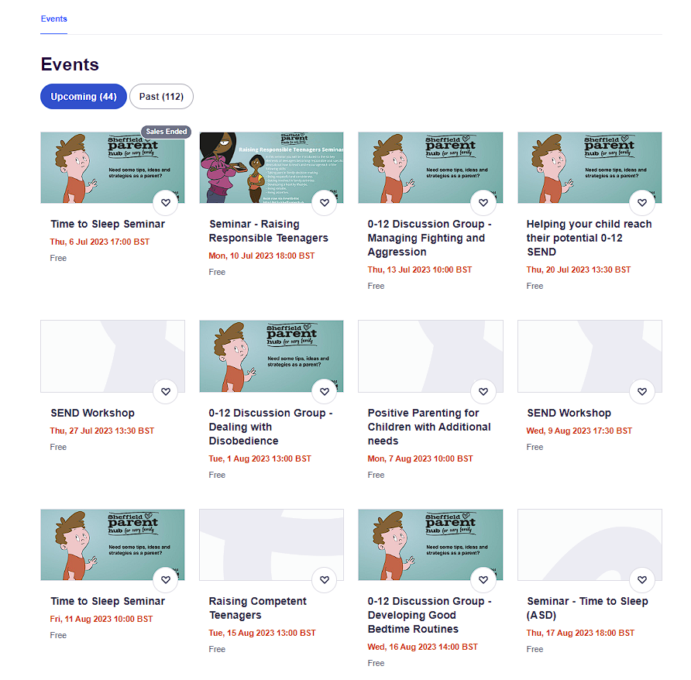
Sheffield Parent Hub:
Sheffield Parent Hub is a fantastic, supportive website to guide parents with SEND children all free of charge.
You can see all upcoming ‘events’ n the link stated below.
https://www.eventbrite.co.uk/o/sheffield-parent-hub-17631456258
Example of the website's homepage and events:

Slide 6


Weekly Attendance
3rd – 7th July 2023
EYFS | Heeley | 88.1%
EYFS | Whirlow | 91.1%
Y1 | Sheaf | 89.3%
Y1/Y2 | Endcliffe | 93.4%
Y2 | Norfolk | 93.6%
Y3 | Crucible | 91.6%
Y3 | Lyceum | 92.2%
Y4 | Kelham | 93.2%
Y4 | Weston | 92.5%
Y5 | Millennium | 90.2%
Y5 | Graves | 92.3%
Y6 | Bolsover | 93.1%
Y6 | Peveril | 93.3%
Y3/Y6 | Shirebrook | 87.1%
Whole School Attendance |  | 91.6%
Remember to be in school every day to make the most of our Summer activities.
At Birley Spa Primary Academy we are committed to helping all pupils to achieve their full potential. Good attendance is a key factor in raising pupils’ attainment and supporting their personal development. Whilst it is appreciated that children are ill from time to time, please think carefully before allowing your child to be absent from school. The chart below provides an indication of how just a few days absence can significantly impact a child’s overall attendance percentage and impede their learning:
Description | Attendance | Whole Days Lost | Lost Hours of Learning
Excellent | 100 – 99% | 0 – 2 | 0 – 10
Good | 98 – 96% | 4 – 7.5 | 20 – 37.5
Requires Improvement | 95 – 91% | 9.5 – 17 | 47.5 – 85
Persistent Absentee | 90 – 86% | 19 – 27 | 95 – 135
Critical | 85 – 80% | 28.5 – 38 | 142.5 – 190

Slide 7
STAR OF THE WEEK
3rd – 7th July 2023
Heeley | Georgios – Endeavour and Resilience showing a ‘can do’ attitude all year. | Arlo – Aspiration in all that he does and producing amazing writing.
Whirlow | Carter – Creativity and Aspiration and always being a Role model. | Louie – Showing Aspiration in following classroom routines.
Sheaf | Darcey – Being an Aspirational learner. You are really stretching and challenging yourself in all subjects. | Rohan – Resilience. Rohan has been showing how he can tackle and overcome things that he finds hard.
Endcliffe | Ezra – Aspiration – Trying really hard in all lessons, Ezra has been participating in class discussions and always keen to learn. | Bryley – Teamwork – Bryley was very supportive in PE; he cheered on his team and encouraged everyone.
Norfolk | Eddie – Combining Creativity and Aspiration to write a terrific letter in English! | Lily – Aspiring to do her best in Maths lessons with wonderful results!
Lyceum | George – Showing real Resilience with your handwriting. You are really trying hard to join in the correct places. I am sure with some more hard work in Year 4, it will look amazing! | Marnie – Showing Resilience and Endeavour this week. You have worked hard with your writing and it was great to see your enthusiasm to complete your work on Pompeii.
Crucible | Imogen – Using her spelling log all the time. You have shown real Endeavor with spelling! | Remarniz – Always working hard and producing work to the best of his ability.
Weston | Luca - Showing a positive attitude to his learning and good learning behaviors. | Jacey - Showing Aspiration in Maths and moving her learning to the next level.
Kelham | Conor – An amazing piece of work based on mountain ranges across the world. | Cohan – Amazing progress in Maths. He has really fulfilled his true potential!
Graves | Abbey – Showing Empathy and Tolerance towards all her peers. Well Done on becoming a Bronze Learner! | Keavy – Always showing all the school values. Well done for becoming a Silver Learner!
Millennium | Ella – Showing Aspiration and Resilience in Maths and for always being polite and helpful in and around school. | Lexi – Showing Aspiration and Resilience in Maths and for always showing Role Models behaviour.
Bolsover | Freya – Showing great Teamwork in all lessons. Your confidence is shining through! | Max – His Resilience in and out of the classroom. You are showing lots of determination.
Peveril | Rube – Showing a positive attitude and having high Aspirations. | Frankie –Showing Endeavour and Resilience every day.
Shirebrook | Elijah – Resilience – Elijah has coped really well with all the changes in Shirebrook and shown Resilience when engaging in work and activities. | Junior – Resilience - Junior has coped really well with all the changes in Shirebrook and shown Resilience when engaging in work and activities.

Slide 8
Dates for the Diary
Dates for the Diary
11th July | Sports Day – Y3 & Y4 – 10:00am
11th July | Sports Day – Y1 & Y2 – 1:30pm
12th July | Sports Day – EYFS – 9:15am
12th July | Toddler Group – 9:30 – 10:30am
13th July | Sports Day - Y5 & Y6 – 1:45pm
14th July | Reports Sent Home
17th July | Summer Fayre
19th July | Toddler Group – 9:30 – 10:30am
20th July | Year 6 Leavers Assembly for parents – 1:30pm
21st July | Whole School Family Picnic
21st July | Last day of term
4th – 5th September | Inset Days – School Closed
6th September | School Reopens to children

