Slide 1
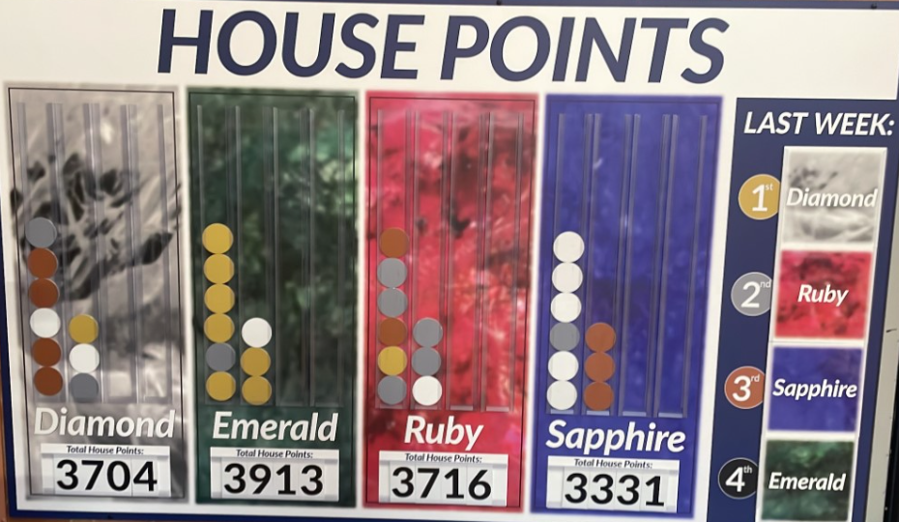


Follow us: @BirleySpaAcad
Newsletter
18th November 2022
Our children have been amazing gaining so many house points!
Well Done to Emerald team with 3913 points!

Slide 2

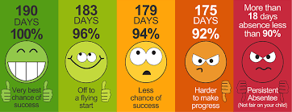
Follow us: @BirleySpaAcad
Attendance Figures 14th – 18th November 2022
Class | Attendance %
Whirlow | 88.1%
Heeley | 87.3%
Sheaf | 88.1%
Endcliffe | 97.7%
Norfolk | 97.2%
Crucible | 92.5%
Lyceum | 93%
Kelham | 95.3%
Weston | 95.7%
Millennium | 92.3%
Graves | 93.8%
Bolsover | 94.3%
Peveril | 91.3%
Shirebrook | 95%
School Total | 92.9%
Every Monday, we will have an Aspiration Assembly to celebrate the House Points and attendance from the previous week to showcase our vital school values.
Please look out for our updated weekly House Point achievement board and our Attendance Trophy winners who achieve the highest attendance over our 96% target.

Slide 3
STAR OF THE WEEK
Heeley | Poppy – for having great aspiration and using her phonic knowledge to read and write new words. Isla – for showing great resilience with her phonics and persevering when she found it tricky.
Whirlow | Cayleb – for great teamwork when building a beautiful Indian temple with the loose parts. Eliza – for her enthusiasm for learning and her wonderful creativity when singing new songs.
Sheaf | Grace – for showing resilience in her independent writing. Keep up the great work, Grace. Layton – for showing perseverance in his writing this week. Layton is beginning to access resources more independently to support his learning.
Endcliffe | Amelia – for teamwork in class, Amelia is always ready to help others and knows when to listen in group work. Jaxon – for showing aspiration in maths challenging himself with greater numbers in independent work.
Norfolk | Colby – for showing resilience in his maths learning by challenging himself to deepen his understanding and concepts. Ellis – for showing superb teamwork and empathy within the classroom to peers.
Lyceum | Joshua – for showing creativity and aspiration with his independent writing. Joshua is really trying to up level your vocabulary. Keaton – for showing endeavour and aspiration by working hard on his presentation and handwriting.
Crucible | Imogen – for having an open mind on opinions that are different from her own. Fantastic patience, understanding and acceptance for differences. Elizabeth – for having high expectations in her work and working hard to achieve her very best.
Weston | Chance – for showing resilience and determination in maths. Carter – for showing endeavour by independently using resources to aid his writing.
Kelham | Maisey – for showing a resilience across all areas, not getting distracted and showing a real thirst for learning. Lyla – for fantastic endeavour in writing, increasing productivity and completing a super presentation.
Graves | Daniel – for having great amounts of tolerance and empathy with others and going above and beyond to do this. Riley – for aspiring to be kind, hardworking and a resilient learner. Keep up the good work!
Millennium | Thomas – for his resilience in all of his work but most notably in maths where he often works at a very high standard. Olivia – for her endeavour in making sure that all her work is presented to a very high standard.
Bolsover | Olivia- for showing resilience in your learning and for being confident with sharing ideas in class. Addison - for producing a great independent piece of writing in English. You have really practiced your proof reading, well done
Peveril | Flynn – for showing aspiration by editing his work to improve his writing. Ellie – for showing endeavour by not becoming distracted from her work.
Shirebrook | Alex – for taking on a challenge and developing your independence.
Follow us: @BirleySpaAcad

Slide 4
Dates for the Diary
28th November | Enterprise Week
2nd December | Christmas Service at Spa View Church
12th – 16th December | Christmas Events – further information to follow
12th December | Meet the Teacher – New Topics
19th December – 2nd January | Christmas Holidays
3rd February | Y5 Young Voices Concert
13th – 17th February | Half Term – School Closed
20th February | Inset Day – School Closed
27th March | Meet the Teacher – New Topics
28th & 30th March | Parents Evening
31st March | Easter Service at Spa View Church
3rd – 14th April | Easter Holidays – School Closed
17th April | Inset Day – School Closed
1st May | Bank Holiday – School Closed
8th May – 11th May | SATS Week – Y6
15th – 19th May | SATS Week – Y2
29th May – 2nd June | Half Term – School Closed
9th June | Y6 Crucial Crew Visit
12th – 18th June | Phonics Assessment Week
3rd July | Enterprise Week
11th July | Sports Day – Y1 & Y2 / Y3 & Y4
12th July | Sports Day – EYFS
13th July | Sports Day - Y5 & Y6
14th July | Reports Sent Home
17th July | Summer Fayre
21st July | Whole School Family Picnic

